Slide 1


Hackweek 10/10/14
Project XRAY
Swati Shah

Slide 2
QA Engineer – NOVA Squad (Radio, Discover)

Slide 3
Day to Day Life
Test releases to ensure features are working
Improving product quality
Finding bugs to reduce software costs

Slide 4
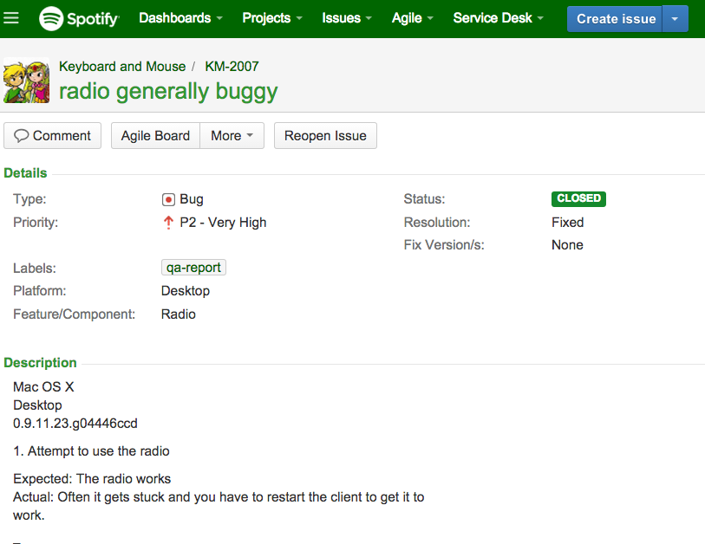
How do I find out about problems…?

Slide 5

Listen to Customer’s Voice

Slide 6
Twitter
User forums

Slide 7
Twitter Data on #SpotifyCares
Data: 100,000 tweets for 1 week
Analysis: Key word searches (Radio, Crashes, Frustrated) into a WordCloud
October 10, 2014

Slide 8
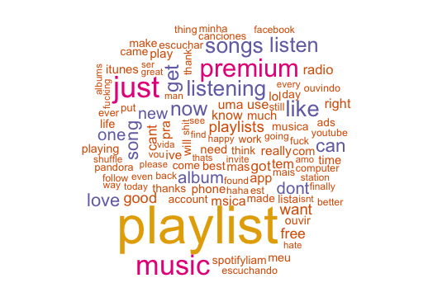
‘Spotify’ in Twitter feed
October 10, 2014

Slide 9
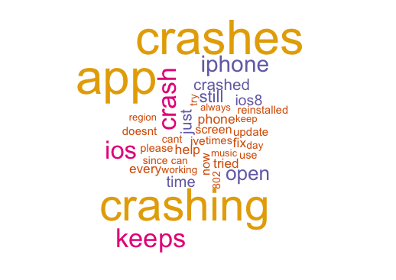
‘Crashes’ in Twitter feed
October 10, 2014

Slide 10
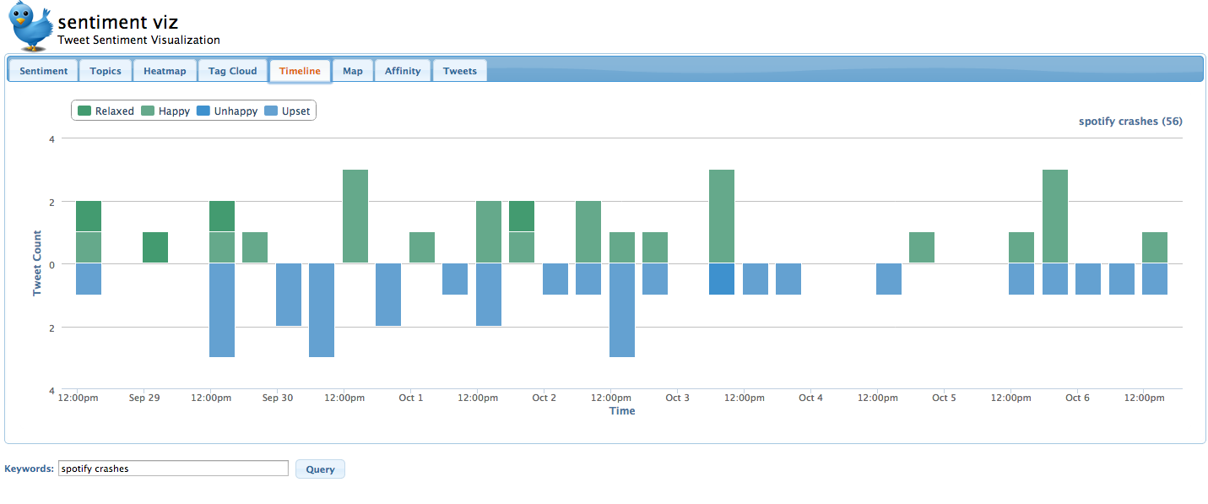
Twitter frequency graph on #SpotifyCares
October 10, 2014

Slide 11
Twitter Topic Graph on #SpotifyCares – based on ‘Crashes’
October 10, 2014

Slide 12
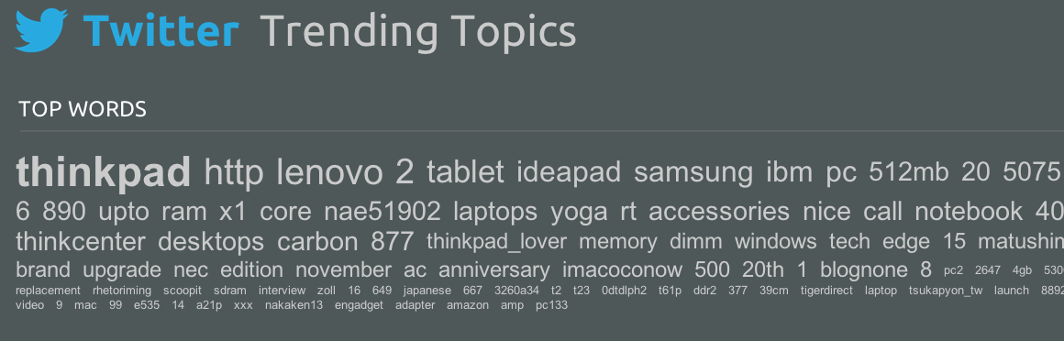
Twitter Top Trending Words on #SpotifyCares
October 10, 2014

Slide 13
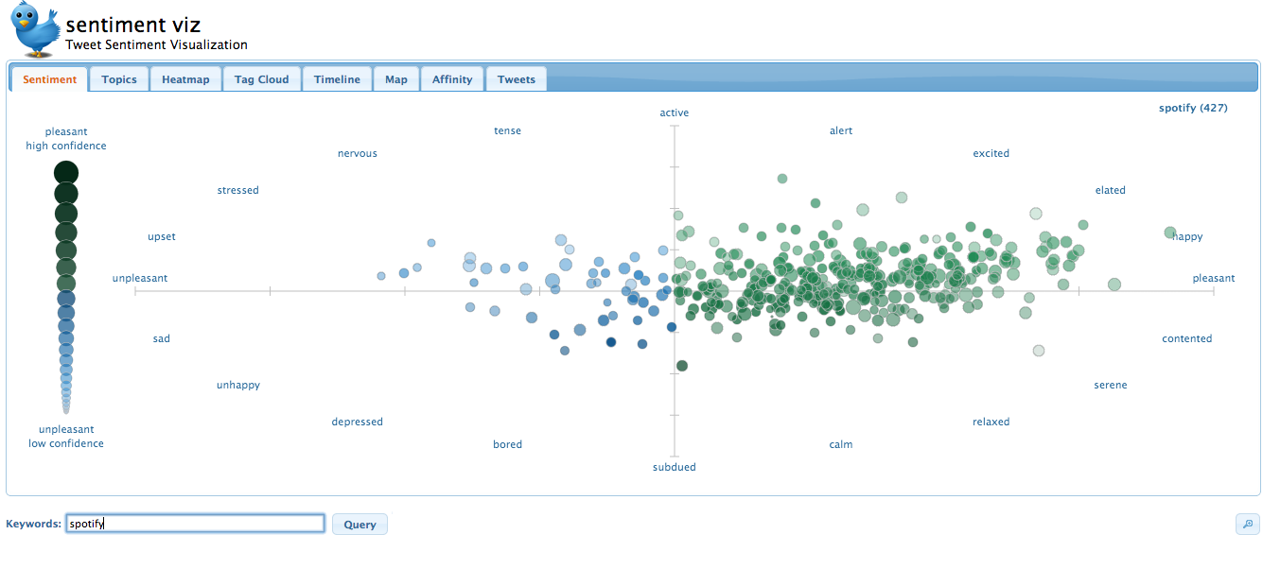
Twitter Sentiment graph on ‘Spotify’
October 10, 2014

Slide 14
Insights about Twitter Feed
Lots of data – give us idea of related words
What is useful for QA…?:
Knowing the frequency of the all tweets and the date/time of tweets
i.e. if tweets go up from 300 per week to 300 a day; near Release Cycle date
Build Early Warning Detection system via Dashboard
This would benefit all feature teams (Ads, Social, Platform)
Use Twitter API for more refined searches
October 10, 2014

Slide 15
User Forum Data on Spotify Community
Data: 10 Users Posts with radio tag
Data is much more detailed, insightful
Analysis: Put data into WordCloud
October 10, 2014

Slide 16
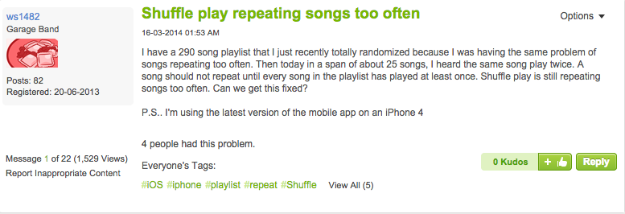
User Post in Forum:
October 10, 2014

Slide 17
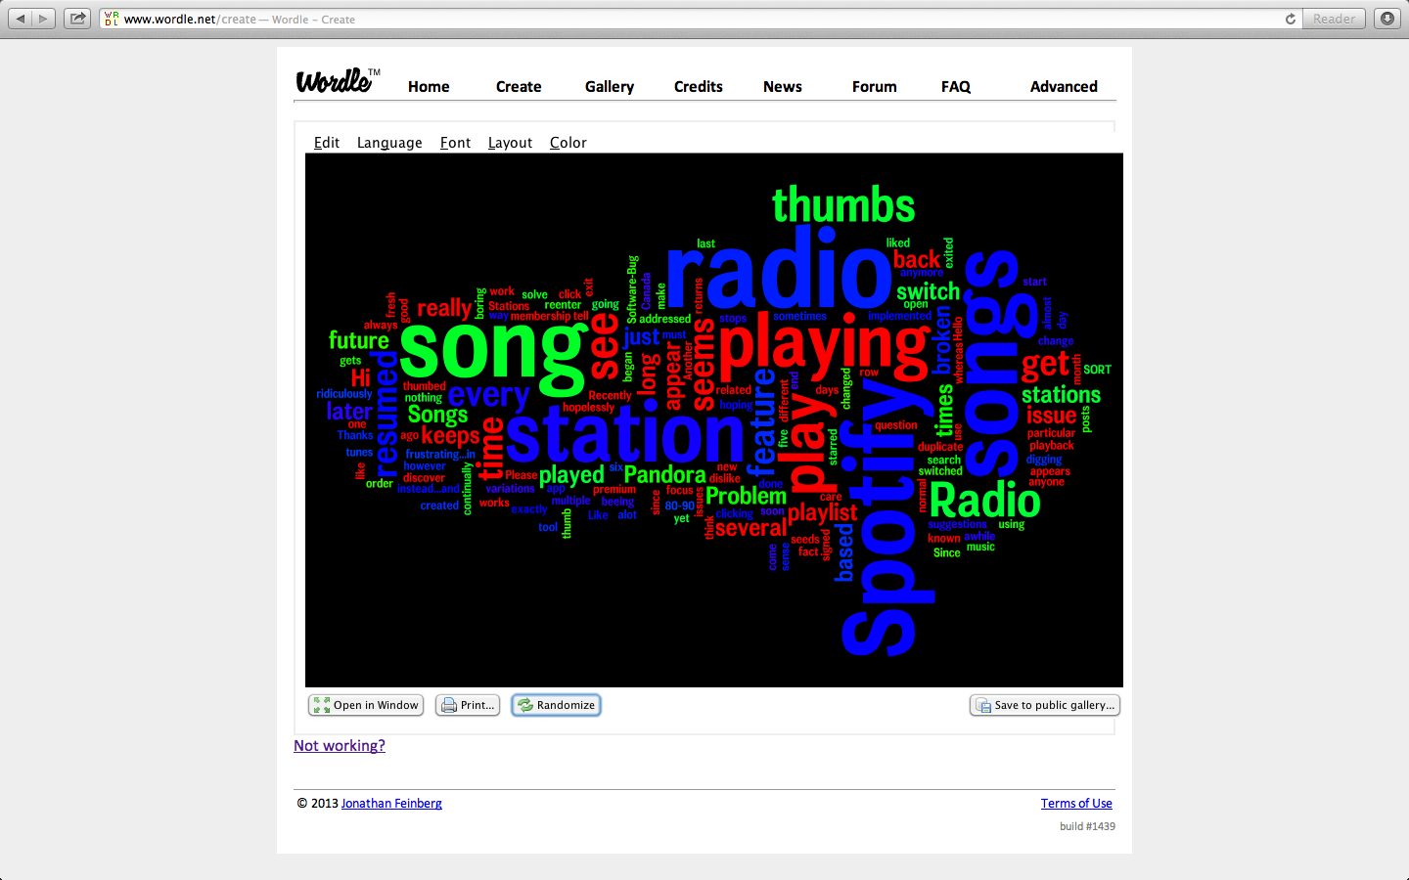
5 User’s Posts with tag ‘Radio’
October 10, 2014

Slide 18
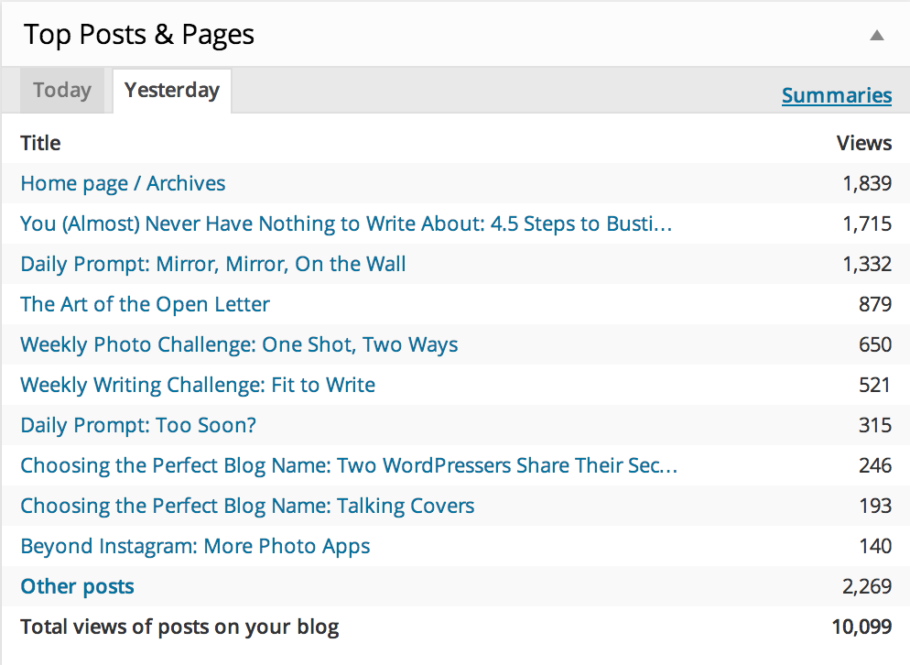
Top # Views of Post (Radio)
October 10, 2014

Slide 19
Top # of Radio Topics
October 10, 2014

Slide 20
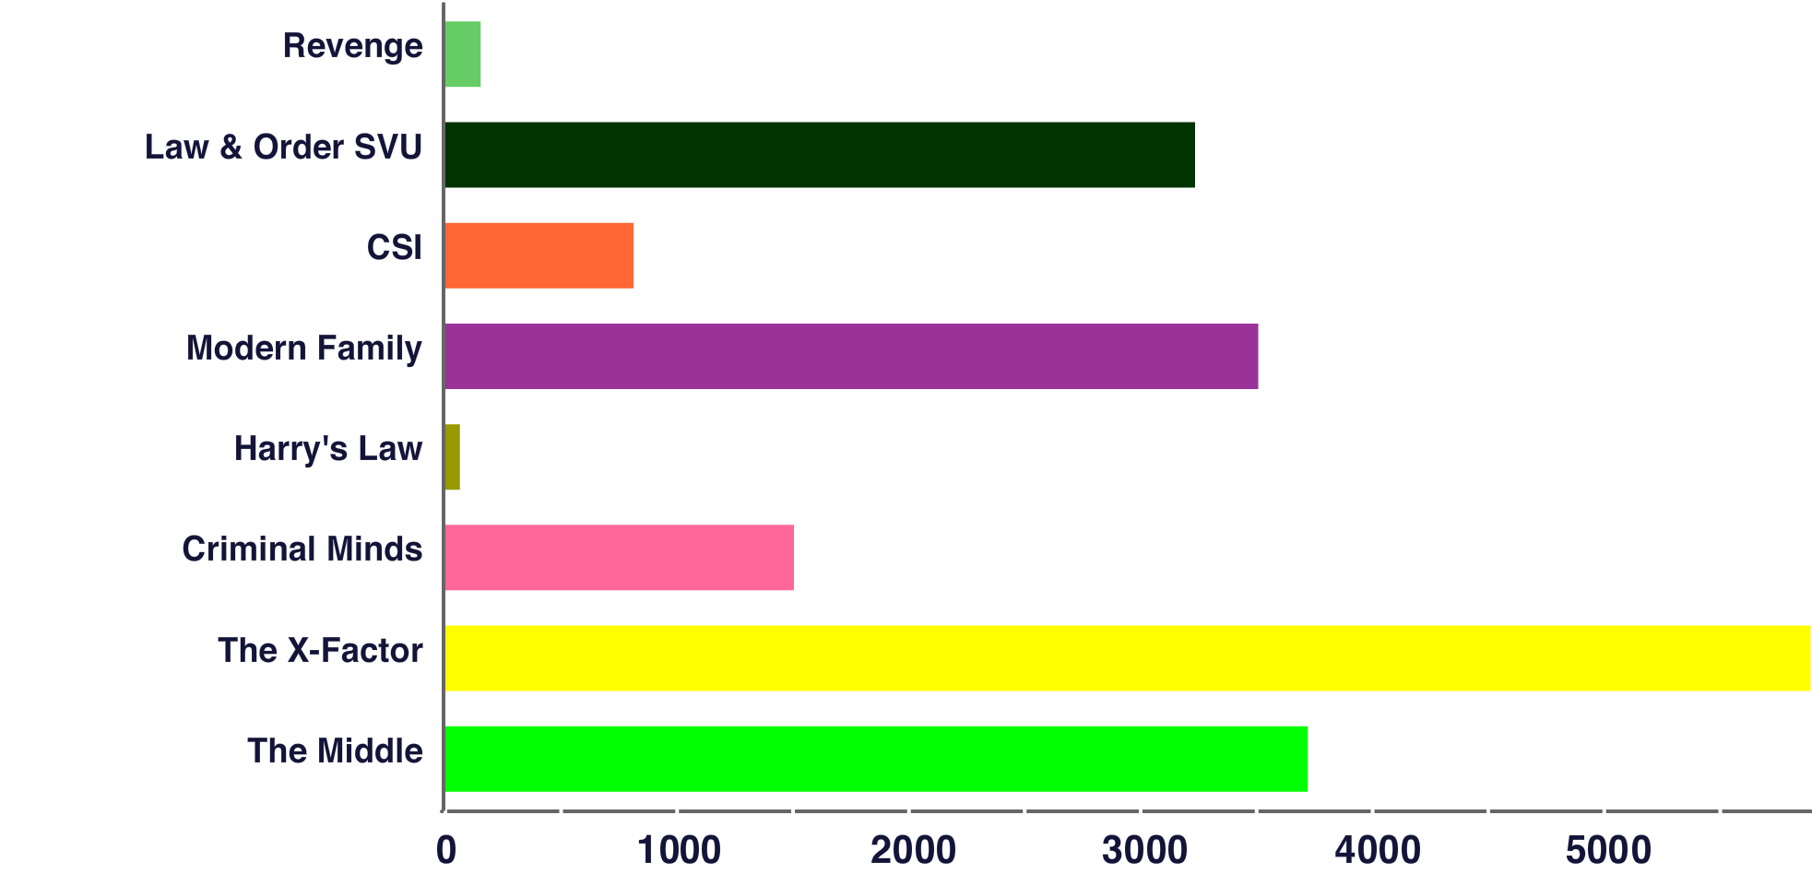
Top Trending Topics – example:
October 10, 2014

Slide 21
Insights about Forum Data
Some posts have detailed information from user perspective (i.e. future tracks)
Generally, less than 10% of users report issues to forums
What is useful to QA…?
Understand users from another perspective
See how they use the product in unexpected way (integration other features)
Customer insights help drive product improvements (i.e. delete stations)
Understand common topics / trends users are experiencing
Get feedback for new releases/features in Radio (repeated tracks)
i.e. New backend services (Apollo) on mobile (iOS & Android) impacts 5+ million users

Slide 22
Vision: XRAY Dashboard

Slide 23
Shout out to:
Sebastian – CS analytics
Rajiv – Data cruncher
Project XRAY – seeing through data

